Slide 1
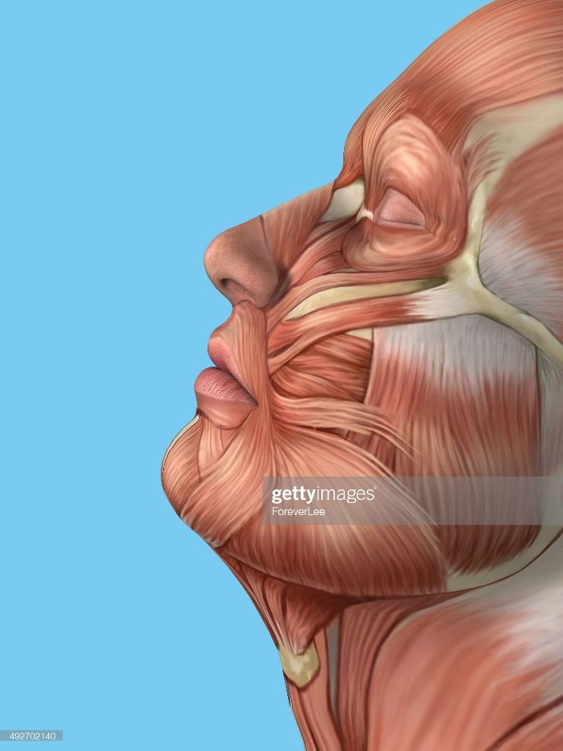


L02-landing-welcome-page-004
scrn_03_00
Welcome to this module on
Welcome to this module on Anatomy of the midface muscles.
Select the Start button to proceed.
Anatomy of the lower face muscles
Start
https://www.gettyimages.in/detail/photo/anatomy-side-view-of-major-face-muscles-royalty-free-image/492702140?adppopup=true
This module contains audio. Make sure that your headphones or speakers are connected and working.
An audio transcript is also available on every screen.

Slide 2
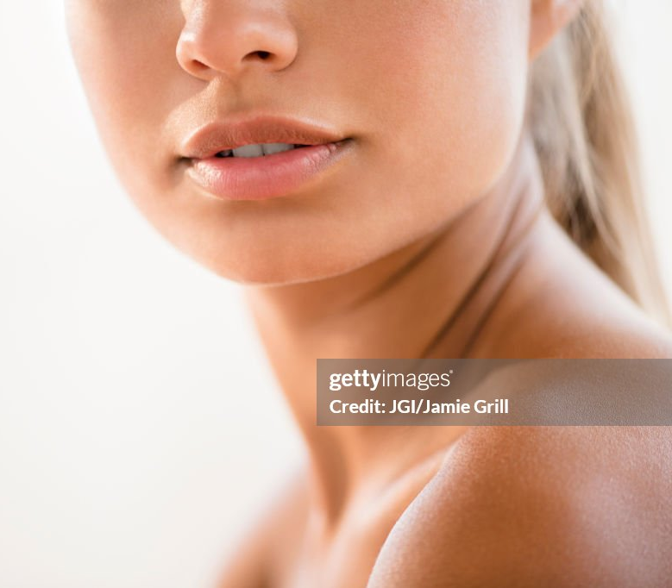


L01-text-image-001
scrn_03_01
Overview
In this module, you will get detailed understanding of the lower face muscles and the anatomy of the fat pads.
In this module, you’ll learn about:
Fat pads and fat compartments in the lower face
Muscles of the lower face
You will need approximately 20 minutes to complete this module.
https://www.gettyimages.in/detail/photo/close-up-of-bare-shoulder-of-mixed-race-woman-royalty-free-image/601798307?phrase=lower+face+human
Bring the page title, image and the first on-screen text together in sync with the audio.
Then bring the objectives and duration info text in the grey patch with last sentence.

Slide 3

vh01-intro-anim-001
scrn_03_04
The muscles of facial expression
Facial muscles and their structure are responsible for our expressions.
Proceed with the video to understand this better.
The structure behind
Select the Play button to start the video.
On clicking ‘Pathophysiology of Cheek Lines’ on the ‘watch’ page, learner will see this video.

Slide 4
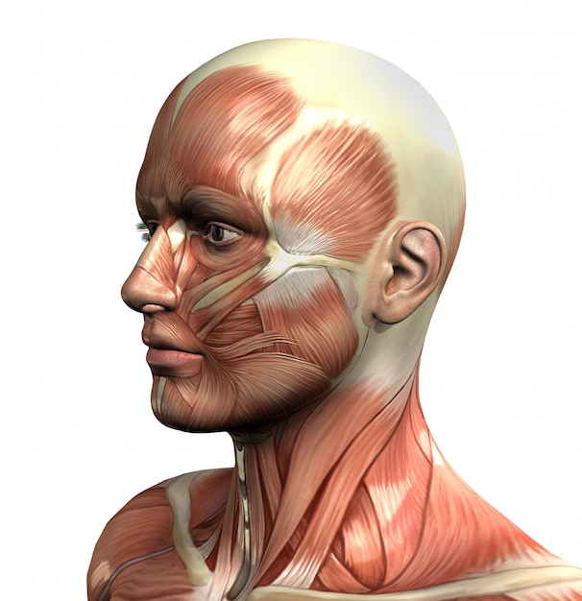
vh01-intro-anim-001
scrn_03_04
The muscles of facial expression
The facial muscles are attached to the facial skeleton or membranous superficial fascia beneath the skin or subcutaneous tissue.
Facial skeleton
Membranous superficial fascia
https://www.freepik.com/free-photo/muscles-head_1036782.htm#query=facial%20muscles%20topography&position=3&from_view=search&track=ais

Slide 5
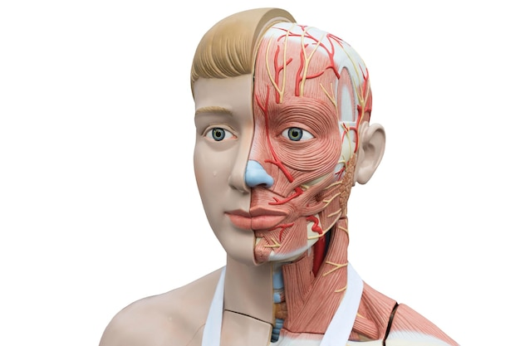
vh01-intro-anim-001
scrn_03_04
The muscles of facial expression
They originate from the facial bone or fascia and insert into the facial skin.
Originate from the facial bone or fascia
https://www.freepik.com/premium-photo/human-model-anatomy-white-background_36053017.htm#query=face%20anatomy&position=24&from_view=search&track=ais

Slide 6
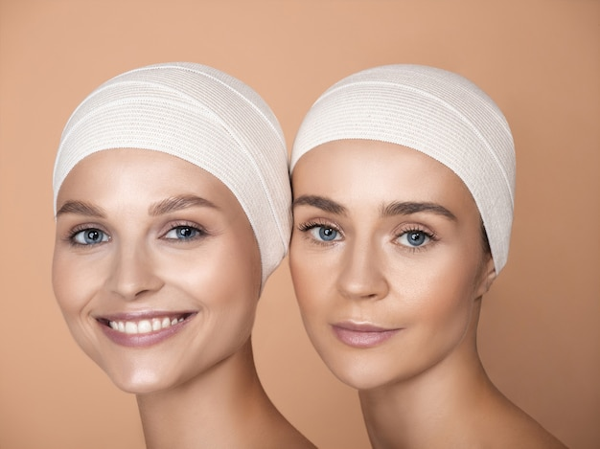
vh01-intro-anim-001
scrn_03_04
The muscles of facial expression
The topography of the facial muscle varies between males and females as well as between individuals of the same gender.
The topography varies…
https://www.freepik.com/free-photo/portrait-beautiful-young-women-brown-studio_13160203.htm#page=2&query=facial%20muscles&position=13&from_view=search&track=ais

Slide 7
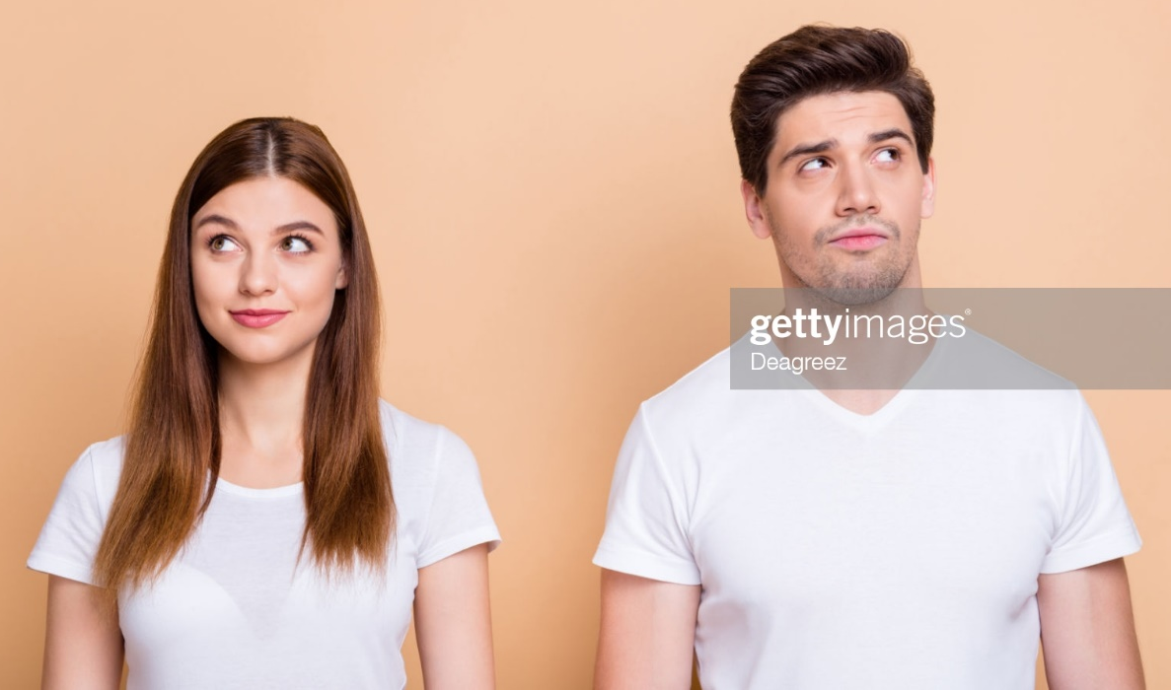
vh01-intro-anim-001
scrn_03_04
The muscles of facial expression
That’s why every individual has unique expressions.
Every individual makes unique expressions
https://www.gettyimages.in/detail/photo/portrait-of-his-he-her-she-nice-attractive-lovely-royalty-free-image/1181385171?adppopup=true

Slide 8
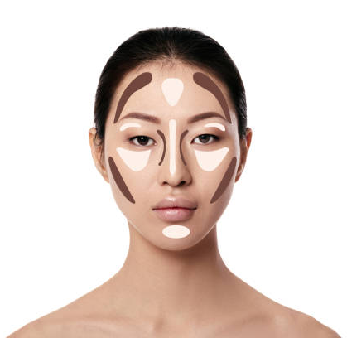
vh01-intro-anim-001
scrn_03_04
The muscles of facial expression
To understand the science behind these expressions, it is important to define the muscle shapes, their associations with the skin, and their relative muscular actions.
Muscle shapes
Association with the skin
Relative muscular actions
https://www.gettyimages.in/detail/photo/make-up-asian-woman-face-on-white-background-royalty-free-image/1131190771?adppopup=true

Slide 9
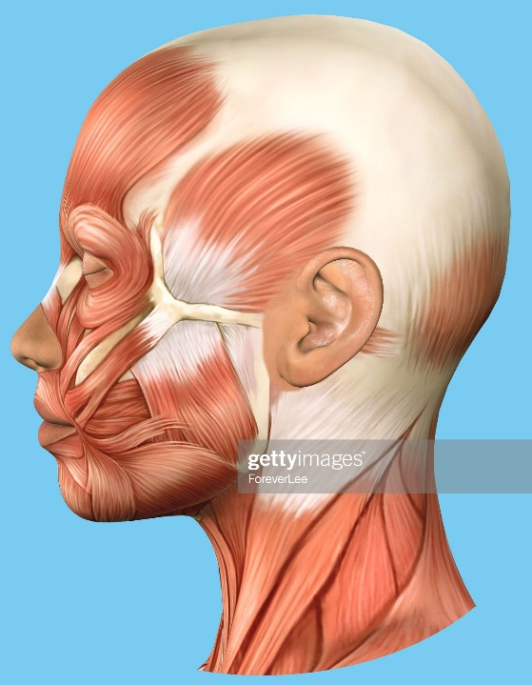
vh01-intro-anim-001
scrn_03_04
The muscles of facial expression
Facial muscles are distributed in different locations and are involved in controlling the opening of the orifices as dilators or sphincters.
The muscles are involved in controlling the opening of orifices
Dilators
Sphincters
https://www.gettyimages.in/detail/photo/anatomy-side-view-of-major-face-muscles-royalty-free-image/492726780?adppopup=true
Or
Can use the 3D model of face here.

Slide 10
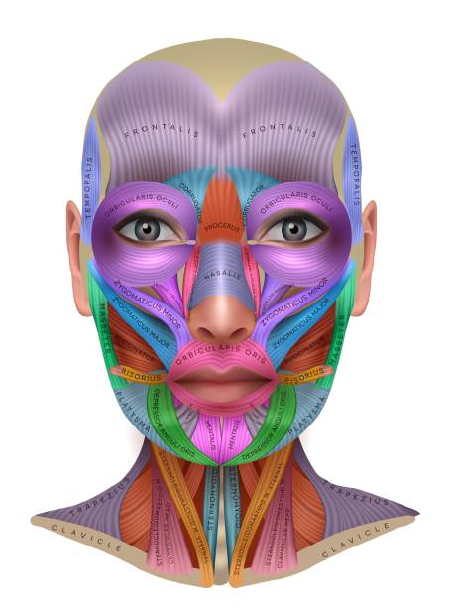
vh01-intro-anim-001
scrn_03_04
The muscles of facial expression
The distribution of the muscles across the face is categorized into four main regions: forehead, …
Regional categorization of the facial muscles:
Forehead
Highlight/zoom each area in sync with VO and dim the remaining area.
https://www.gettyimages.in/detail/illustration/muscles-of-the-face-info-royalty-free-illustration/1193747554?adppopup=true
Or
Can use the 3D model of face here.

Slide 11
vh01-intro-anim-001
scrn_03_04
The muscles of facial expression
…, orbital, …
Regional categorization of the facial muscles:
Orbital
Highlight/zoom each area in sync with VO and dim the remaining area.
https://www.gettyimages.in/detail/illustration/muscles-of-the-face-info-royalty-free-illustration/1193747554?adppopup=true
Or
Can use the 3D model of face here.

Slide 12
vh01-intro-anim-001
scrn_03_04
The muscles of facial expression
…, nose ...
Regional categorization of the facial muscles:
Nose
Highlight/zoom each area in sync with VO and dim the remaining area.
https://www.gettyimages.in/detail/illustration/muscles-of-the-face-info-royalty-free-illustration/1193747554?adppopup=true
Or
Can use the 3D model of face here.

Slide 13
vh01-intro-anim-001
scrn_03_04
The muscles of facial expression
… and perioral.
Regional categorization of the facial muscles:
Perioral
Highlight/zoom each area in sync with VO and dim the remaining area.
https://www.gettyimages.in/detail/illustration/muscles-of-the-face-info-royalty-free-illustration/1193747554?adppopup=true
Or
Can use the 3D model of face here.

Slide 14
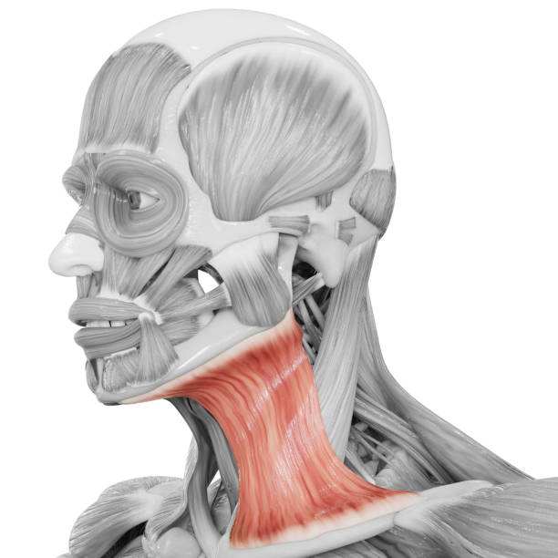
vh01-intro-anim-001
scrn_03_04
The muscles of facial expression
The platysma muscle being an exception, originates from the non-facial area. It is included in the perioral region as it is involved in the perioral movement.
Platysma muscle
https://www.gettyimages.in/detail/photo/human-body-muscular-system-head-muscles-platysma-royalty-free-image/1296087614?adppopup=true
Or
Can use the 3D model of face here.

Slide 15
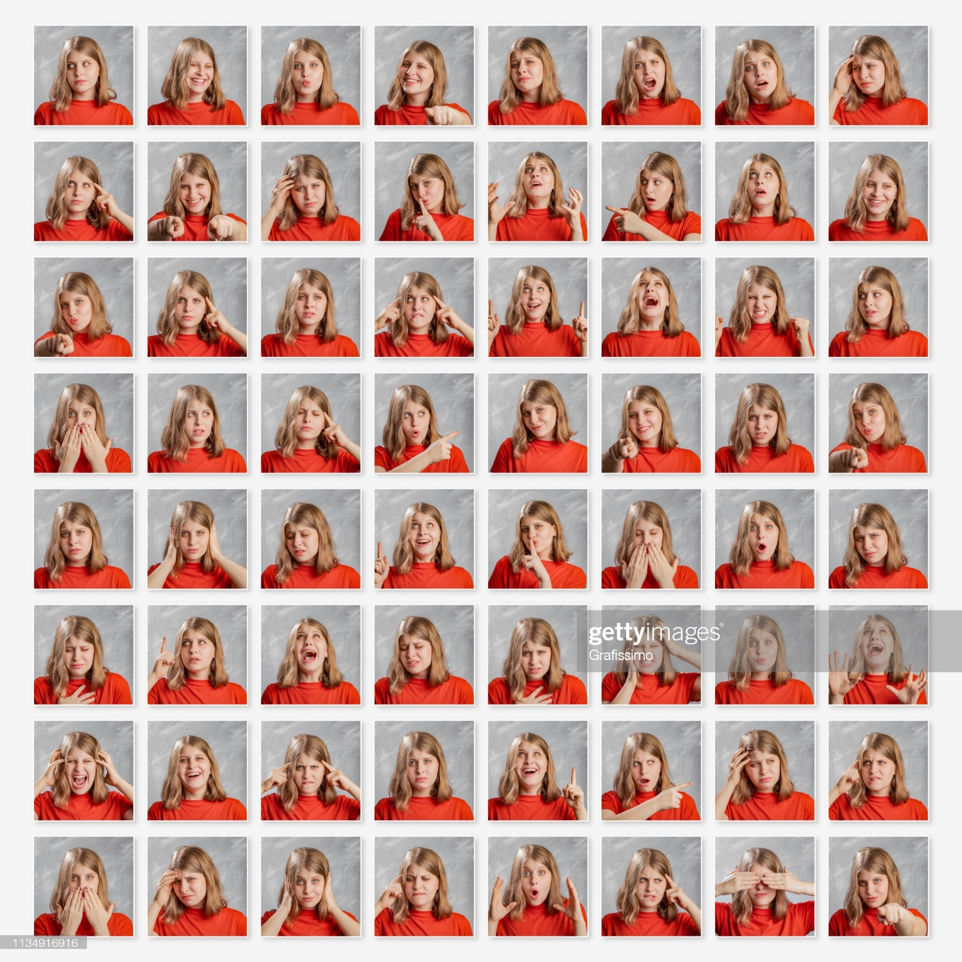
vh01-intro-anim-001
scrn_03_04
The muscles of facial expression
Together, all these facial muscles reveal various expressions such as sadness, anger, joy, fear, disgust, and surprise to name a few.
We work on treating the facial muscles for those perfect expressions.
Facial muscles reveal various expressions
Sadness
Joy
Disgust
Anger
Fear
Surprise
https://www.gettyimages.in/detail/photo/blonde-woman-with-different-emotions-and-gestures-royalty-free-image/1134916916?adppopup=true

Slide 16
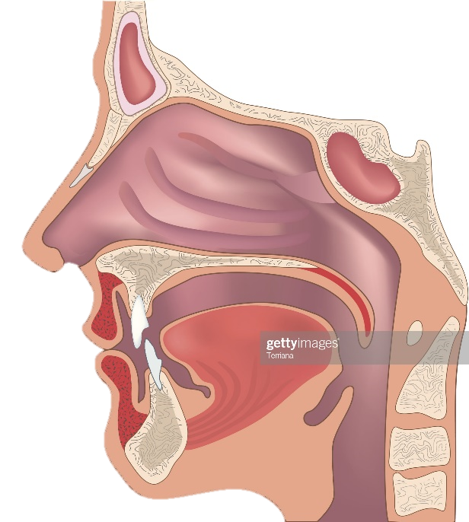
L04-overview-003
scrn_00_00
Intrinsic muscles of the lip and cheek
The muscles of lip and cheek are a part of perioral muscles group. The perioral muscles are located in modiolus, upper lip and lower lip regions.
Let’s start with the intrinsic muscles of lip and cheek – orbicularis oris and buccinator muscle.
Select the tabs for an overview of these muscles.
The perioral muscles are located in modiolus, upper lip
and lower lip regions.
Select the tabs for a quick glance at the anatomy of fat pads.
https://www.gettyimages.in/detail/illustration/human-nose-and-throat-structure-royalty-free-illustration/451330851
Orbicularis oris
Buccinator muscle

Slide 17
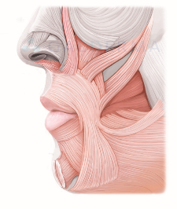
--
--
The orbicularis oris muscle is a mouth constrictor surrounding the mouth region.
Most muscle fibers are continued from various muscles in the mouth region.
The intrinsic orbicularis oris muscle fibers originate from the alveolar bone of the maxillary and mandibular incisors.
This muscle closes the mouth and puckers the lips.
Orbicularis oris
CLOSE
Mouth constrictor
Continued from various muscles in mouth region
Originate from alveolar bone of the maxillary and mandibular incisors
Closes the mouth and puckers
the lips
<>

Slide 18
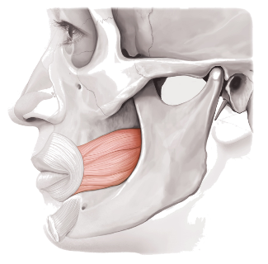
--
--
The buccinator muscle originates from the lateral side of the alveolar portion of the maxillary and mandibular molars and the anterior border of the pterygomandibular raphe.
Buccinator muscle
CLOSE
Originates from the lateral side of the alveolar portion of the maxillary and mandibular molars and the anterior border of the pterygomandibular raphe.
Use fade-in and fade-out within this popup.

Slide 19
--
--
The buccinators consist of four bands: the first superior band originating from the maxilla, the second band originating from the pterygomandibular raphe, the third band originating from the mandible, and the fourth band (the inferior band) originating inferiorly to the third band and extending inferomedially and then proceeding inferiorly to the orbicularis oris muscle fibers.
The inferior band, unlike the other bands, continues bilaterally to the median plane of the mandible.
Buccinator muscle
CLOSE
4 bands:
Originates from maxilla – superior band
Originates from pterygomandibular raphe
Originates from mandible
Originates inferior to the third band and proceeds inferiorly to the orbicularis oris muscle fibers – continues bilaterally to the median plane of the mandible
1
2
3
4
Use fade-in and fade-out within this popup.
Sync the numbered connectors with the numbered bullet points.

Slide 20
vh01-intro-anim-001
scrn_03_04
The modiolus
The modiolus is a fibromuscular structure that forms the major part of perioral muscles.
Proceed with the video for a detailed understanding.
The structure behind
Select the Play button to start the video.
On clicking ‘Pathophysiology of Cheek Lines’ on the ‘watch’ page, learner will see this video.

Slide 21

vh01-intro-anim-001
scrn_03_04
The modiolus
In 21.4% of the Koreans, the modiolus shows tendinous tissue instead of muscles, and this area of convergence consists of dense, irregular collagenous connective tissues.
21.4% of Koreans
Tendinous tissue
Dense, irregular collagenous connective tissues
https://www.freepik.com/free-photo/portrait-expressive-young-woman_11702156.htm#page=3&query=korean+female&position=22

Slide 22
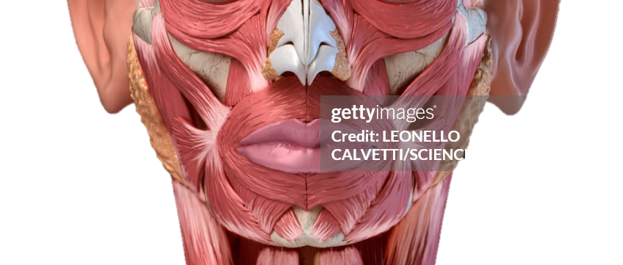
vh01-intro-anim-001
scrn_03_04
The modiolus
The modiolus muscle lies either superior or inferior to the intercheilion line.
Superior or inferior to the interchillion line
https://www.gettyimages.in/detail/illustration/human-head-anatomy-illustration-royalty-free-illustration/1178749271?phrase=lower+face+muscles+front+view

Slide 23

vh01-intro-anim-001
scrn_03_04
The modiolus
In Asians, the modiolus lies 11.0±2.6 mm laterally and 8.9±2.8 mm inferior to the cheilion and inferior to the intercheilion line.
The characteristics are commonly observed in most Asians
Asians
11.0±2.6 mm laterally
8.9±2.8 mm inferior to the cheilion
inferior to the intercheilion line
https://www.freepik.com/free-photo/young-beautiful-woman-looking-camera-trendy-girl-casual-summer-white-t-shirt-jeans-shorts-positive-female-shows-facial-emotions-funny-model-isolated-yellow_8270063.htm#page=2&query=happy+people++happy+woman&position=2

Slide 24

vh01-intro-anim-001
scrn_03_04
The modiolus
Whereas in the Caucasians, the modiolus lies on or superior to the intercheilion line.
Caucasians
On or superior to the intercheilion line
https://www.freepik.com/free-photo/portrait-smiling-casual-woman_6812784.htm#page=3&query=caucasian&position=15

Slide 25
vh01-intro-anim-001
scrn_03_04
The modiolus
The modiolus muscle is a dense, compact, and mobile muscular node formed by a convergence of muscle fibers from the zygomaticus major, depressor anguli oris, risorius, orbicularis oris, buccinators, and levator anguli oris.
Zygomaticus major
Orbicularis Oris
Levator anguli orius
Modiolus
Depressor anguli orius
Risorius
https://www.gettyimages.in/detail/illustration/human-head-anatomy-illustration-royalty-free-illustration/1178749271?phrase=lower+face+muscles+front+view

Slide 26
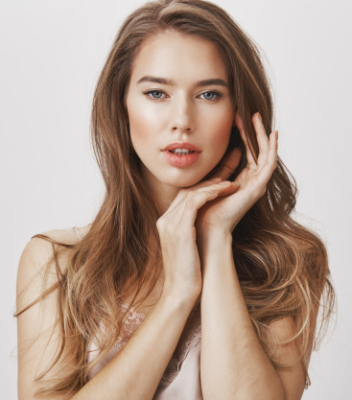
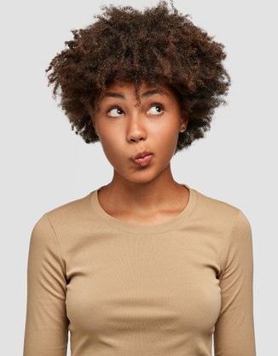
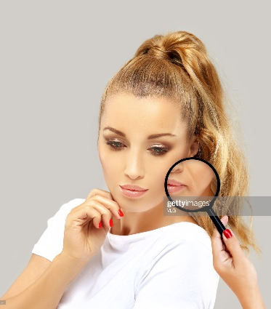

vh01-intro-anim-001
scrn_03_04
The modiolus
It is strongly associated with facial expressions, beauty, aging, and the formation of the nasolabial folds.
Beauty
Facial expressions
Nasolabial folds
Aging
https://www.freepik.com/free-photo/young-lovely-female-has-dark-skin-clueless-unaware-expression-purses-lips-looks-with-puzzlement-upwards-isolated-white-wall_10421699.htm
https://www.freepik.com/free-photo/passionate-beautiful-woman-looking-camera_9475309.htm#page=2&query=facial+expressions&position=3
https://www.freepik.com/free-photo/close-up-image-good-looking-beautiful-mature-blonde-female-with-blue-eyes-elegant-makeup-pixie-hairstyle-smiling-having-confident-happy-facial-expression-being-good-mood_11890554.htm#page=1&query=facial+expressions&position=29
https://www.gettyimages.in/detail/photo/aging-mature-woman-young-woman-face-with-skin-royalty-free-image/1266229505

Slide 27


vh01-intro-anim-001
scrn_03_04
The modiolus
The subtle and detailed facial expressions are formed by the muscles terminated at the modiolus.
Subtle expressions
Detailed expressions
https://www.freepik.com/free-photo/charming-friendly-young-caucasian-woman-stylish-clothes-sitting-desk-with-hands-her-face-with-interest-smiling-happily-human-facial-expressions-body-language_11163759.htm#page=1&query=facial+expressions&position=30
https://www.freepik.com/free-photo/cute-girl-stylish-striped-shirt-sitting-her-workplace-with-elbows-desk-pillowing-face-hands-looking-away-with-bored-thoughtful-facial-expression-thinking-how-entertain-herself_11163758.htm#page=1&query=facial%20expressions&position=28

Slide 28
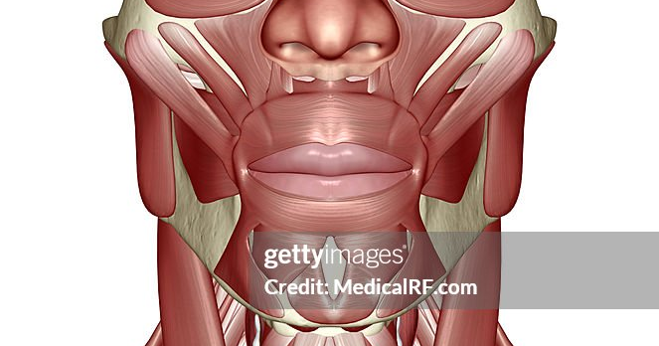
m14-cl-hotspot-001
scrn_00_00
Muscles inserted into the modiolus
Multiple muscles are inserted into the modiolus structure.
Multiple muscles are inserted into the modiolus structure.
Select each hotspot to learn more.
Select each hotspot to learn more.
+
+
+
+
https://www.gettyimages.in/detail/illustration/the-muscles-of-the-head-neck-and-face-royalty-free-illustration/87320478?phrase=lower+face+muscles+front+view

Slide 29
m14-cl-hotspot-001
scrn_00_00
Muscles inserted into the modiolus
Multiple muscles are inserted into the modiolus structure.
The zygomaticus major muscle originates from the facial side of the zygomatic bone, proceeds inferiorly and medially, joining the orbicularis oris muscle, and inserts into the modiolus.
The insertion pattern varies, but it is always observed that the fiber runs deeper than the levator anguli oris muscle. These fibers insert into the anterior region of the buccinators.
Select each hotspot to learn more.
Zygomaticus major (ZMj)
Originates from the facial side of zygomatic bone, proceeds inferiorly and medially
Runs deeper than levator anguli oris, joins orbicularis oris muscle, and inserts into modiolus
+
Orbicularis Oris
+
Modiolus
+
https://www.gettyimages.in/detail/illustration/the-muscles-of-the-head-neck-and-face-royalty-free-illustration/87320478?phrase=lower+face+muscles+front+view

Slide 30
m14-cl-hotspot-001
scrn_00_00
Muscles inserted into the modiolus
Multiple muscles are inserted into the modiolus structure.
The levator anguli oris muscle originates from the canine fossa inferior to the infraorbital foramen, blends with the orbicularis oris muscle, and inserts into the modiolus.
Its function is to elevate the mouth corner.
Select each hotspot to learn more.
Levator anguli oris (LAO)
Originates from canine fossa inferior to infraorbital foramen
Blends with orbicularis oris, and inserts into modiolus
Functions to elevate mouth corner
+
Orbicularis Oris
+
Modiolus
+
https://www.gettyimages.in/detail/illustration/the-muscles-of-the-head-neck-and-face-royalty-free-illustration/87320478?phrase=lower+face+muscles+front+view

Slide 31
m14-cl-hotspot-001
scrn_00_00
Muscles inserted into the modiolus
Multiple muscles are inserted into the modiolus structure.
The depressor anguli oris muscle is a triangular muscle on the most superficial layer of the perioral muscles, along with the risorius muscle.
It arises from the oblique line of the mandible and merges with the depressor labii inferioris muscle at the origin.
This muscle proceeds narrower to the mouth corner that is modiolus and merges with the depressor labii inferioris muscle at the origin and the risorius muscle.
Select each hotspot to learn more.
Depressor anguli oris (DAO)
Triangular muscle on the most superficial layer
Arises from the oblique line of the mandible
Proceeds narrower to the modiolus
Merges with the depressor labii inferioris muscle at the origin and the risorius muscle
+
+
+
Modiolus
Risorius
Depressor labii inferioris
https://www.gettyimages.in/detail/illustration/the-muscles-of-the-head-neck-and-face-royalty-free-illustration/87320478?phrase=lower+face+muscles+front+view

Slide 32
m14-cl-hotspot-001
scrn_00_00
Muscles inserted into the modiolus
Multiple muscles are inserted into the modiolus structure.
The risorius muscle is a thin muscle that is predominantly located 20-50 mm lateral to the mouth corner and 0-15 mm below the intercheilion horizontal line.
Most fibers originate from SMAS, the parotid fascia, and the masseteric fascia. They sometimes also originate from the platysma muscle. The fibers insert into the modiolus and pull the mouth corner when the person is smiling.
Select each hotspot to learn more.
Risorius
Thin muscle located 20-50 mm lateral to the mouth corner and 0-15 mm below the intercheilion horizontal line
Mostly originate from SMAS, the parotid fascia, and the masseteric fascia, and can also originate from the platysma muscle
The fibers pull the mouth corner when the person is smiling
+
+
+
https://www.gettyimages.in/detail/illustration/the-muscles-of-the-head-neck-and-face-royalty-free-illustration/87320478?phrase=lower+face+muscles+front+view

Slide 33
m14-cl-hotspot-001
scrn_00_00
Muscles inserted into the modiolus
Likewise, the content is covered through animations, videos, and interactions.
Next section is scenario-based activity.
<>
<>

Slide 34
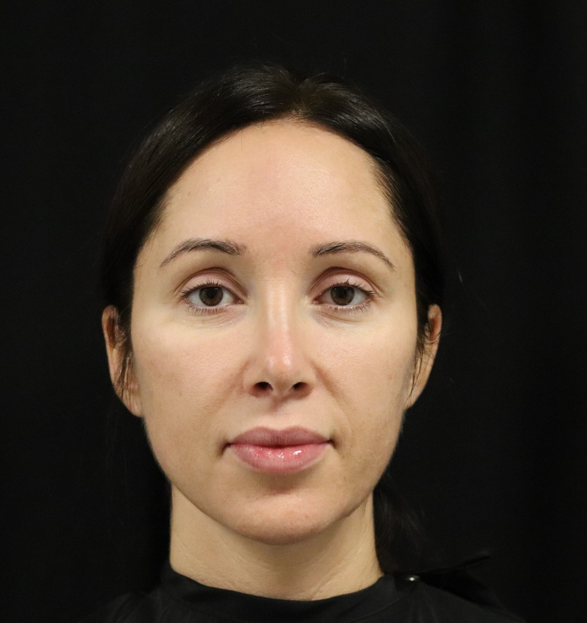
L06-kc-samc-001
scrn_03_26
Practice
Susan is facing some issues with her lower face. She approaches you for the cosmetic treatment.
You need to target specific muscles in the lower face area to address her concerns.
Proceed to the next screen to answer a couple of questions regarding what you’ve learned till now.
Susan is facing some issues with her lower face. She approaches you for the cosmetic treatment.
You need to target specific muscles in the lower face area to address her concerns.
Can you answer a couple of questions regarding what you’ve learned till now?
Continue
Image from client assets

Slide 35


L06-kc-samc-001
scrn_03_27
Practice
Susan: My lips don’t close properly when I try to. What could be the reason?
Which facial muscles you would target to address Susan’s concern?
Revisit Scenario
Stella is facing issue with her smile – says she gets wrinkles on her face when she smiles.
Which facial muscles you would target to address Stella’s concern?
Choose the correct options and submit.
Select the correct option(s) and Submit.
Levator anguli oris (LAO)
Risorius
Orbicularis oris
Depressor labii inferioris (DLI)
Submit
Show the OST as a speech bubble from the patient.

Slide 36
--
--
--
<>
You got it!
The orbicularis oris muscle located in the upper lip region closes the mouth and puckers the lips.
<>

Slide 37
--
--
<>
Not quite.
Please try again.
Try Again
<>

Slide 38
--
--
--
<>
Not quite.
The orbicularis oris muscle located in the upper lip region closes the mouth and puckers the lips.
<>

Slide 39
L06-kc-samc-001
scrn_03_27
Practice
Susan is concerned about a dimple on the chin. She feels it’s a sign of aging.
Which muscle should you target to get rid of this dimple for Susan?
Revisit Scenario
Susan is also concerned about a dimple forming on the chin and feels it’s a sign of aging.
Which muscle should you target to get rid of this dimple for Susan?
Choose the correct option and submit.
Select the correct option and Submit.
Superficial layer of the zygomaticus major muscle
Mentalis muscle
Zygomaticus minor muscle
Buccinators
Submit
Show the OST as a speech bubble from the patient.

Slide 40
--
--
--
<>
You are right!
The mentalis muscle in the chin area that is also called as contracting muscle of the chin, is responsible for the dimple forming in this area.
<>

Slide 41
--
--
<>
Not quite.
Want to try again?
Try Again
<>

Slide 42
--
--
--
<>
Not really.
The mentalis muscle in the chin area that is also called as contracting muscle of the chin, is responsible for the dimple forming in this area.
<>

Slide 43

L12-summary-002
scrn_01_05
Take home messages
You have come to the end of this module. The key points from this module are:
You have come to the end of this module. Here is a snapshot of what we covered in this module.
01
02
03
Facial muscles originate from the facial bone or fascia and insert into the facial skin.
Fat pads are broadly categorised as superficial and deep facial fat pads. Deep facial fat has two compartments – temporal fat compartment and buccal fat compartment.
Fillers should be injected deep to the malar fat pad in the pre-zygomatic space. The injection volume should range between 1.0 ml - 2.0 ml.
<>
Revisit Section
Revisit Section
Revisit Section

Slide 44
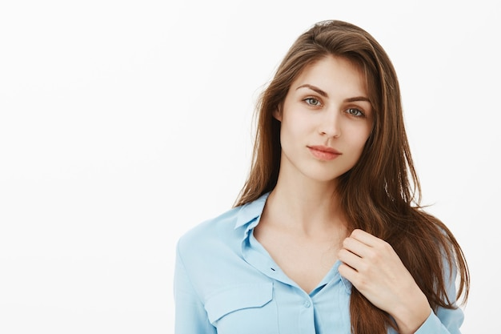
L14-certificate-003
scrn_03_33
You have completed the module successfully.
Select 'Exit' to close the module or 'Menu' button to revisit any topic.
<>
https://www.freepik.com/free-photo/good-looking-brunette-businesswoman-posing-studio_10623459.htm#query=young%20beautiful%20woman&position=6&from_view=search&track=ais

