Slide 1

Getting on Board
Course duration: XX min
Turn on your device’s sound to listen to the audio.
Notes:
Audio script:
Welcome to the induction training program. This module is designed to introduce you to the overall organizational structure, employee culture, and the life at AirWays Airlines. Let’s get on board!

Slide 2
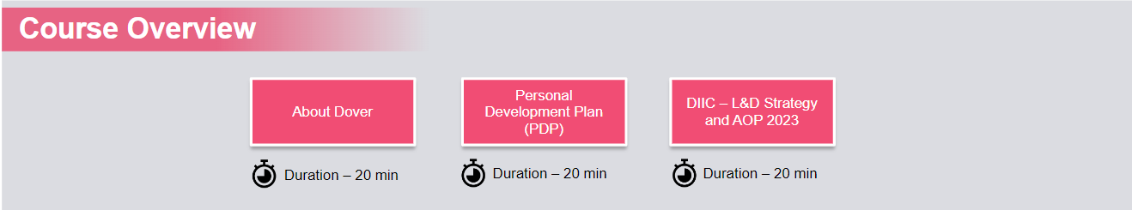
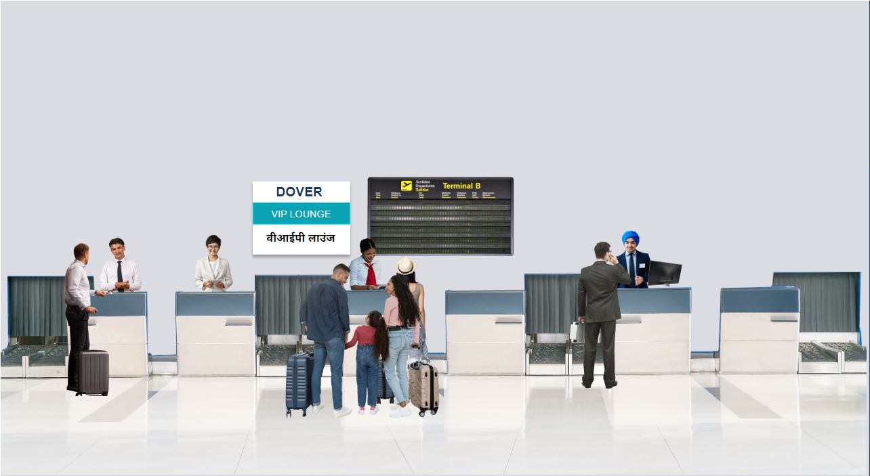

My Personal Development at AirWays
My Learning Opportunities
at AirWays
About AirWays
25 min
25 min
10 min
AIRWAYS
Notes:
Audio script:
Hello, welcome to the AirWays Airlines!
Today I will introduce you to the company and its overall business structure.
Along the journey, we will visit three destinations, namely – About AirWays, My Personal Development at AirWays, and My Learning Opportunities at AirWays. Each destination will cover multiple topics and a time-bound quiz at the end. You need to complete the quiz at each destination to get the entry pass for the next destination. Are you ready? Let’s go.
Media Notes:
Please show diverse and multiethnic people on the airport.

Slide 3

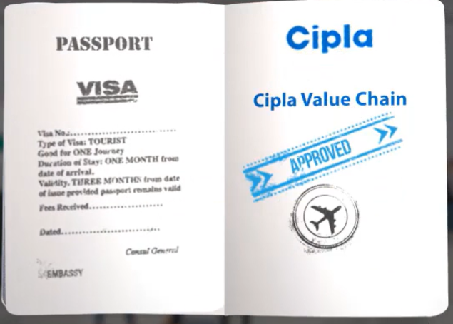
AirWays Airlines
About AirWays
Notes:
Audio script:
Here is your visa and passport. Let’s begin the journey…

Slide 4

Course Objectives
Along the journey, you will learn more about...
Who we are and what we do
Our 5 major operating segments
Personal Development Plan (PDP)
Leadership competencies
S.M.A.R.T. goals
Learning Opportunities at AirWays
Notes:
Audio script:
Before we board the plane, let’s go through the itinerary listed here, to have an overall idea of what we will cover.

Slide 5
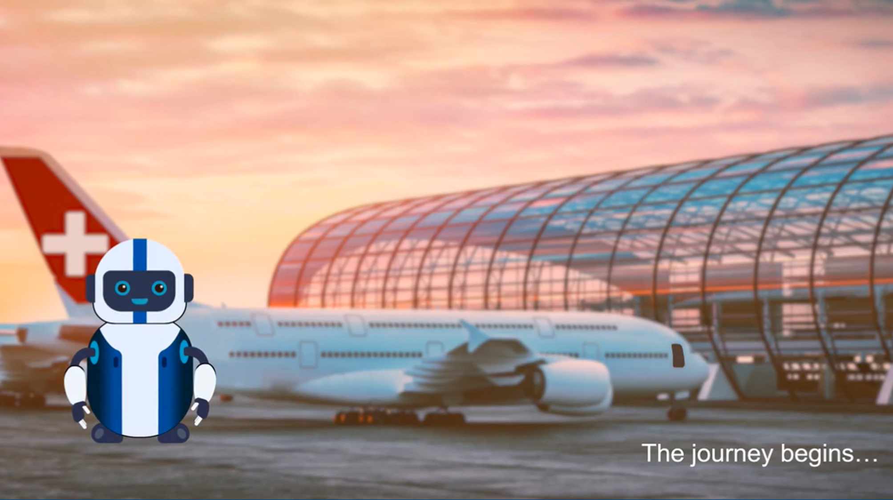
Notes:
Audio script:
The journey begins… Time to fly off to our first destination – About AirWays.

Slide 6

Module Objectives
Understand what is AirWays, what we do and our global footprint
Understanding our Values
5 major operating segments at AirWays
Learn about our unique business model approach
Discuss the history and evolution of AirWays Airlines
Notes:
Audio script:
Here’s what you will be able to do by the end of module 1 – About AirWays.

Slide 7


About AirWays
Unique Business Model Approach
History and Evolution
Global Footprint
Major Operating Segments
Values
Module Introduction: Virtual Tour
Major Footprints In India
Accomplishments
Notes:
Audio script:
Go through is the list of topics we will cover in this module.
Media notes:
The topics will be highlighted in sequence, one by one. Add visual indication for the active topic for learners’ understanding. Add a visual indication for the topics which are completed (maybe a tick mark or highlighting the active topic and making others dull).
Highlight the 1st topic at the end of the audio.

Slide 8

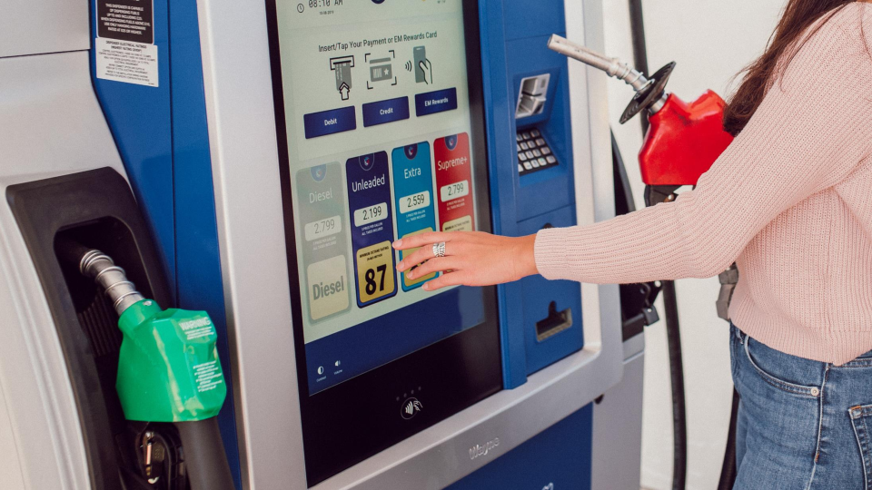


Module Introduction: Virtual Tour
A multi-billion dollar enterprise
Diversification
We believe in:
Equal employment opportunity
Notes:
Audio script:
Let’s begin with an overview of What AirWays is.
AirWays is a multi-billion dollar enterprise, spread across multiple regions worldwide. We believe in diversification and equal employment opportunity.
Developer notes:
Show this video (slides 10-12) on a display behind the seat.
Add zoom-in animation to show that the video screen is behind a seat in the plane.

Slide 9
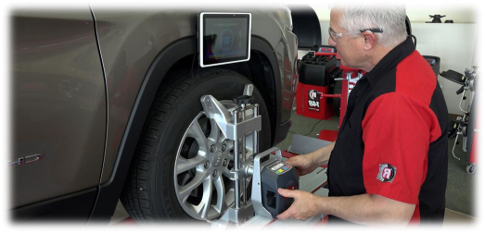
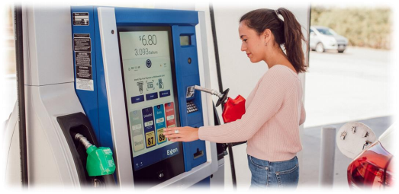

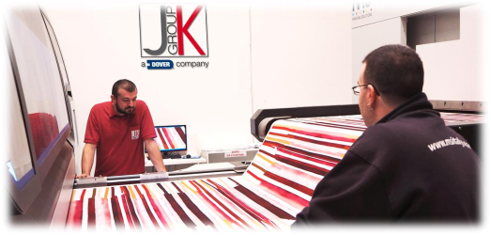
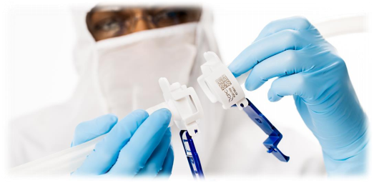

Module Introduction: Virtual Tour
Global manufacturer, operating across five segments:
Engineered Products (EP)
Clean Energy and Fueling (CEF)
Climate and Sustainability Technologies (CST)
Imaging and Identification (InI)
Pumps and Process Solutions (PPS)
Select the Play button to launch the video.
What we do?
Notes:
Audio script:
We are a global manufacturer operating across five different segments – Engineered Products (EP), Clean Energy and Fueling (CEF), Imaging and Identification (InI), Pumps and Process Solutions (PPS), and lastly Climate and Sustainability Technologies (CST).
Watch this video to get a better insight into what we do.

Slide 10

Virtual Tour
Who we are? What we do?
Placeholder for the video
Notes:
Audio script:
None
Media notes:
Fade off the text after a couple of seconds when video starts.

Slide 11
About AirWays
Unique Business Model Approach
History and Evolution
Global Footprint
Major Operating Segments
Values
Module Introduction: Virtual Tour
Major Footprints In India
Accomplishments
Notes:
Audio script:
None
Media notes:
Highlight the 2nd topic.

Slide 12

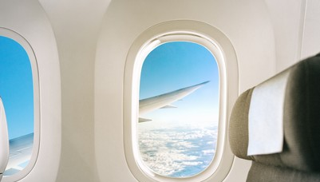





Accomplishments
18000 employees
12 operating companies
5 operating segments
60 years of entrepreneurship
company
$9 billion
annual revenue
We are redefining what’s possible through PERFORMANCE and INNOVATION
Notes:
Audio script:
The five operating segments we just saw, function through 12 operating companies, employing over 18,000 people. We are a Fortune 500 company that amounts to an annual revenue of approximately 9 billion dollars. We have achieved this all over a period of 60 years of the entrepreneurial journey.
Through our performance and innovation, we are redefining what’s possible.
Media notes:
Show this on a magazine page in the plane.

Slide 13
About AirWays
Unique Business Model Approach
History and Evolution
Global Footprint
Major Operating Segments
Module Introduction: Virtual Tour
Values
Major Footprints In India
Accomplishments
Notes:
Audio script:
None
Media notes:
Highlight the 3rd topic.

Slide 14
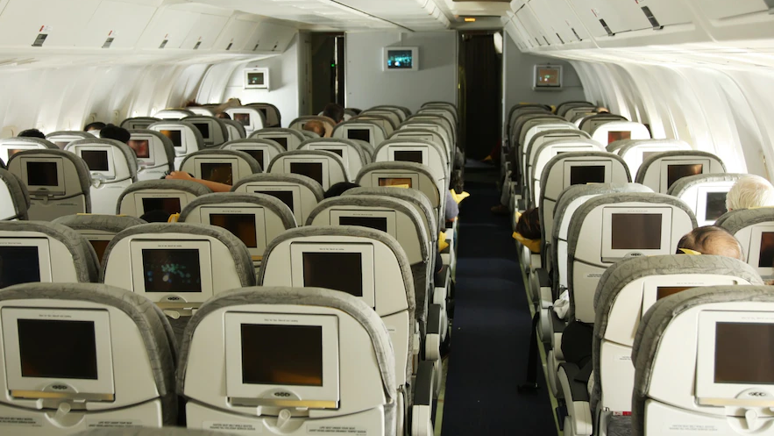
About AirWays
Notes:
Audio script:
Hey, what’s coming on screen? It’s A B C, our CEO. Let’s hear what he wants to say.
Media notes:
Show a display screen in the plane and add a screenshot of the video to be developed for slides 15-17.
Zoom in to the display on the front wall before playing the video.

Slide 15

Our Values
Placeholder for the video
Notes:
Audio script:
Let’s listen to what our CEO has to say.
Click the play button to launch the video.
Media notes:
Zoom in to the display screen of this slide and then play the video.

Slide 16


Our Values
Our dedicated employees embody our values
We deliver what we promise
Values are the basis of how we do our jobs and how we make decisions
Notes:
Audio script:
Across the organization, our dedicated employees embody our values to protect and enhance our reputation for quality and performance. We deliver what we promise. Our values are the basis of how we do our jobs and how we make decisions.
Let’s proceed to view some real-life examples of how our employees express our values in their work.

Slide 17
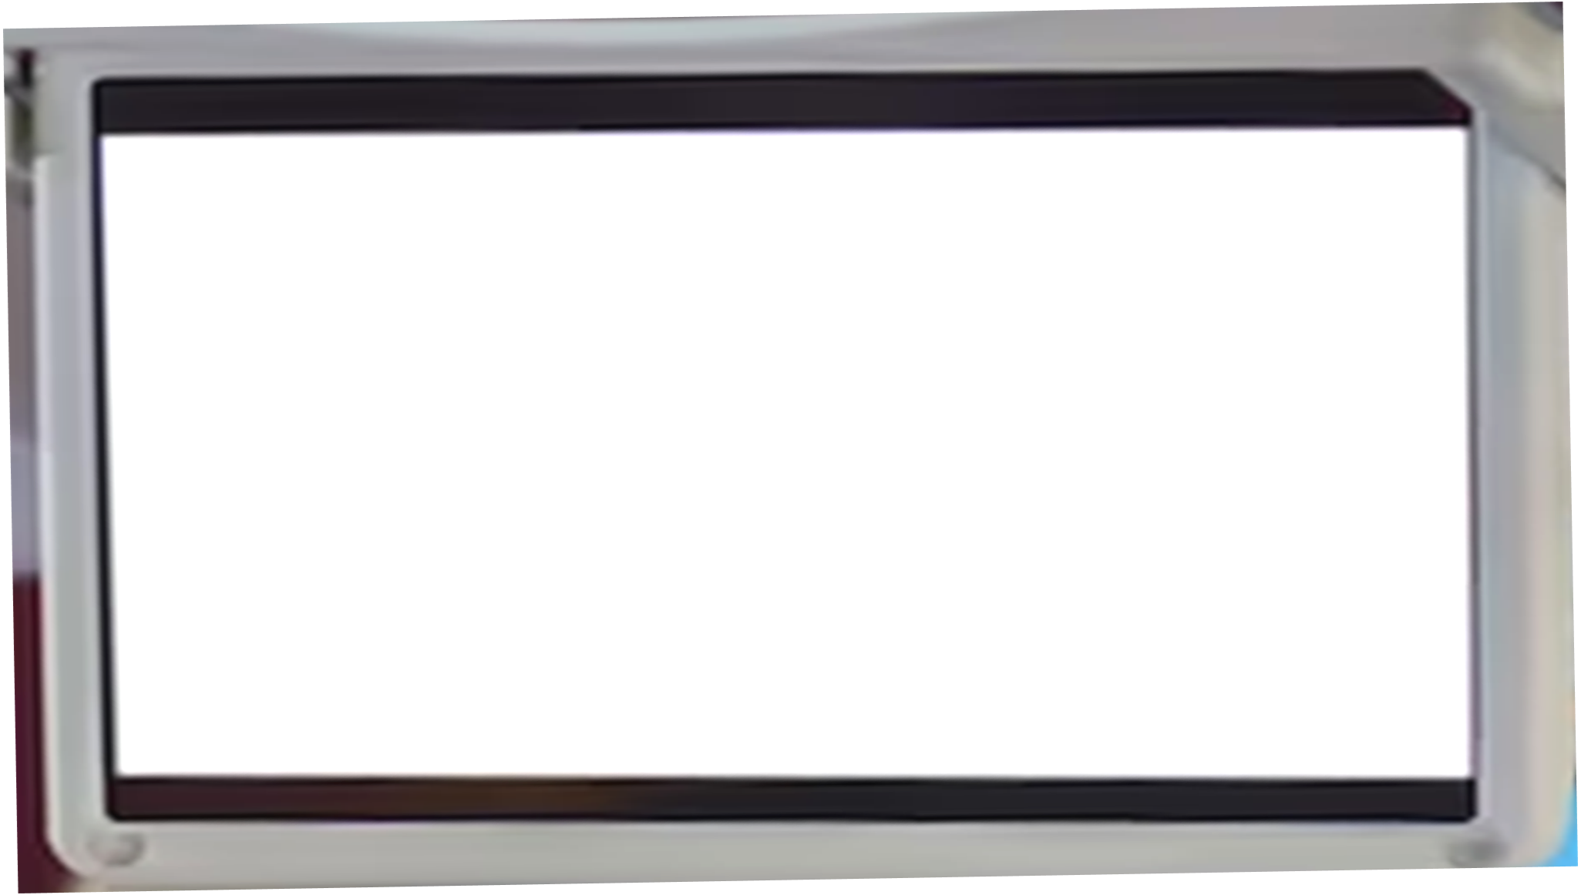
Our Values
Placeholder for the video
Notes:
Audio script:
None

Slide 18
About AirWays
Unique Business Model Approach
History and Evolution
Global Footprint
Major Operating Segments
Module Introduction: Virtual Tour
Values
Major Footprints In India
Accomplishments
Notes:
Audio script:
None
Media notes:
Highlight the 4th topic.

Slide 19

About AirWays
Notes:
Audio script:
Let’s look down through the window…. Imagine AirWays spread across those multiple locations all over the world!
Media notes:
Add top view of earth as seen from the plane window

Slide 20

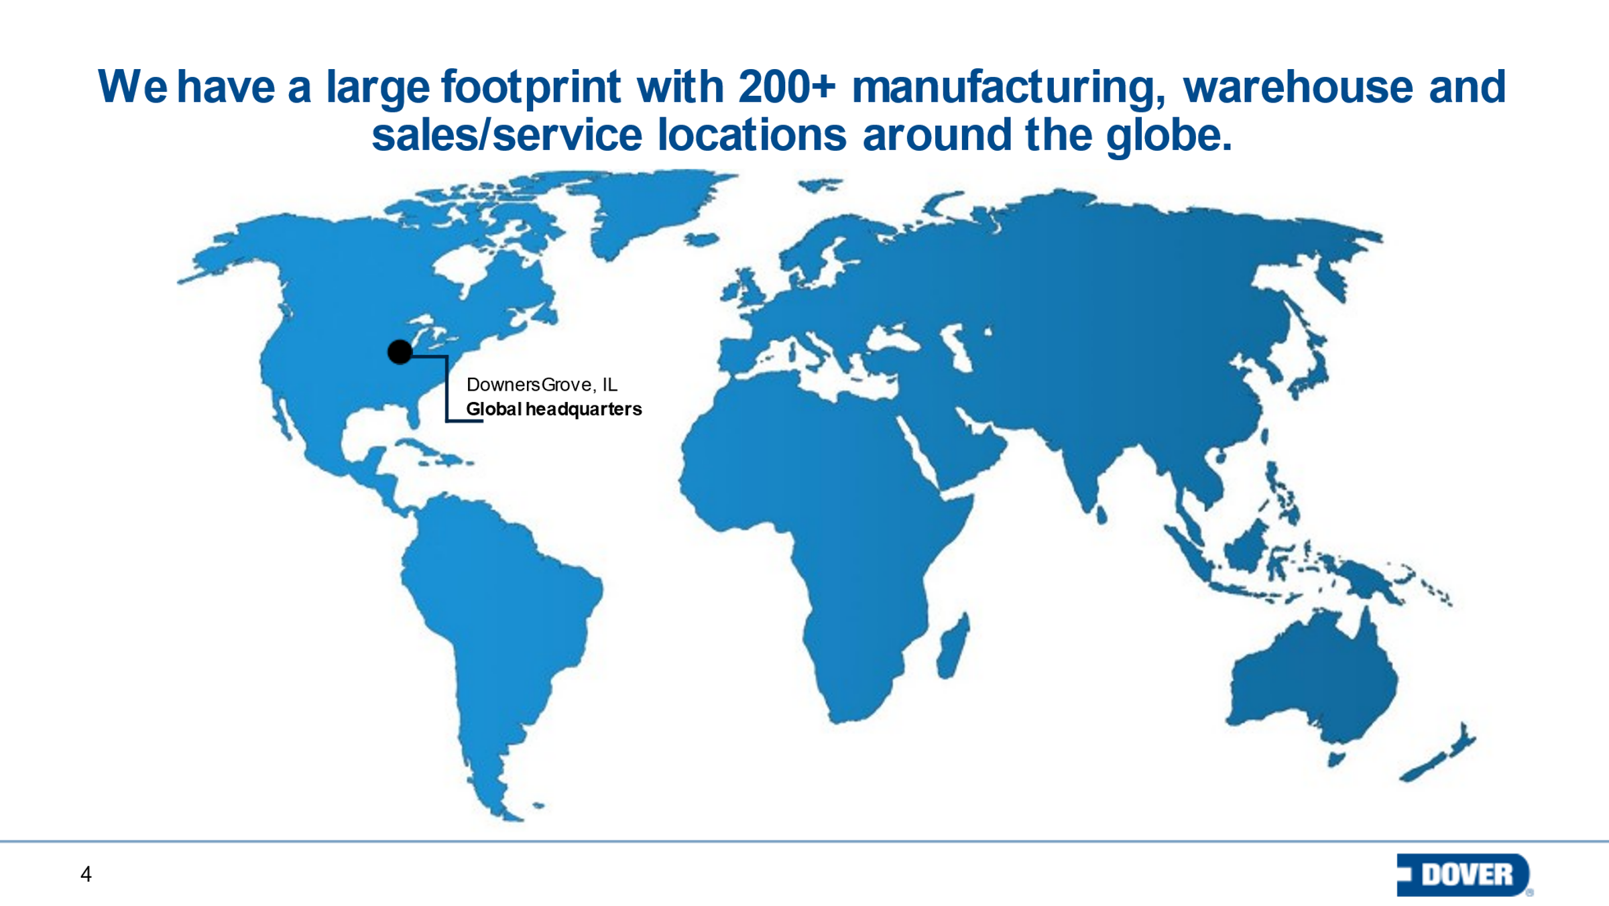
Global Footprint
200+ manufacturing, warehouse and sales/service locations
Notes:
Audio script:
We have a large footprint with over 200 manufacturing, warehouse, and sales/service locations around the globe.
Media notes:
Fade in the world map from the top view we see from the plane as on previous screen. Show the world map initially, without the location circles. Fade in the location circles randomly till the audio continues.

Slide 21
About AirWays
Unique Business Model Approach
History and Evolution
Global Footprint
Major Operating Segments
Module Introduction: Virtual Tour
Values
Major Footprints In India
Accomplishments
Notes:
Audio script:
None
Media notes:
Highlight the 5th topic.

Slide 22

About AirWays
Select the images to learn more.
Notes:
Audio script:
The air hostess is showcasing something. It’s a pamphlet about five major segments across which AirWays operates. Would you like to study each segment? Let’s proceed.
Media notes:
Add Airplane staff showcasing pamphlet with five major operating segments.
Create a pamphlet-like layout for the clickables – one pamphlet containing 5 clickables
Develop click and reveal interaction for the images.

Slide 23
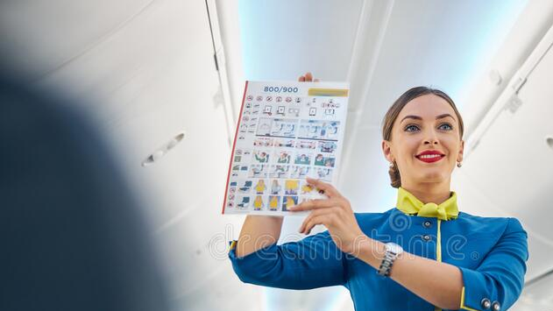
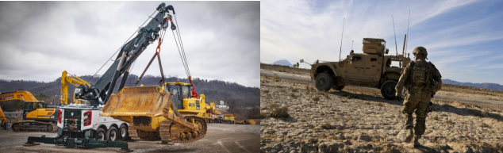
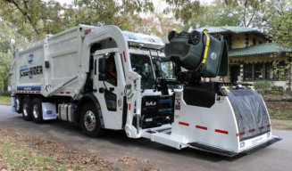
Major Operating Segments
Engineered Products (EP)
Delivers industry-leading equipment, components and software
Serves the vehicle service, environmental solutions and industrial markets
Select the images to learn more.
Notes:
Audio script:
Engineered Products (EP)
The EP segment delivers industry-leading equipment, components and software that serves the vehicle service, environmental solutions and industrial markets.
Media notes:
Create a pamphlet-like layout for the clickables – one pamphlet containing 5 clickables
Develop click and reveal interaction for the images.

Slide 24
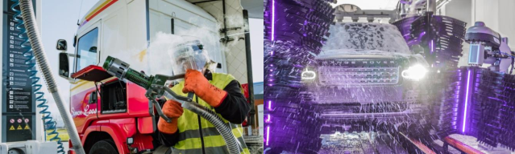
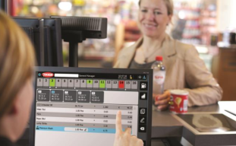
Major Operating Segments
Clean Energy and Fueling (CEF)
A comprehensive portfolio of safety and efficiency solutions for the convenience retail, fueling and clean energy, cryogenic gas and vehicle wash markets
Select the images to learn more.
Notes:
Audio script:
Clean Energy and Fueling (CEF)
The CEF segment provides a comprehensive portfolio of safety and efficiency solutions for the convenience retail, fueling and clean energy, cryogenic gas and vehicle wash markets.

Slide 25

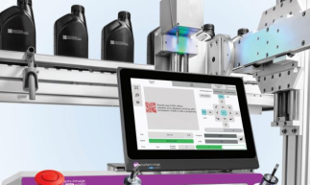
Major Operating Segments
Imaging and Identification (InI)
Leads the design and manufacture of equipment, consumables and software
Provides support services for digital printing and product identification markets
Select the images to learn more.
Notes:
Audio script:
Imaging and Identification (InI)
The InI segment leads the design and manufacture of equipment, consumables and software. It also provides support services for the digital printing and product identification markets.

Slide 26
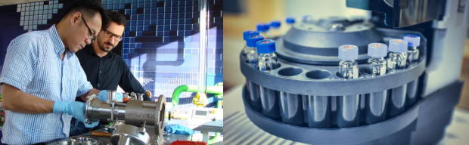

Major Operating Segments
Pumps and Process Solutions (PPS)
Creates performance critical solutions and products for safe handling of fluids across the chemical, hygienic, biopharma, oil and gas and industrial markets
Select the images to learn more.
Notes:
Audio script:
Pumps and Process Solutions (PPS)
The PPS segment creates performance critical solutions and products for the safe handling of fluids across the chemical, hygienic, biopharma, oil and gas and industrial markets.

Slide 27
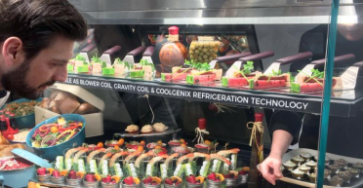
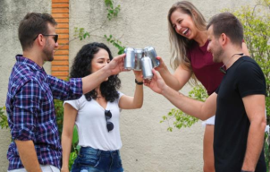
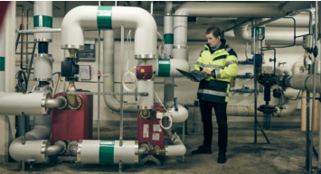
Major Operating Segments
Climate and Sustainability Technologies (CST)
Responsible for developing and supplying innovative and energy efficient equipment and systems
Serving the commercial refrigeration, heating and cooling and beverage packaging equipment markets
Select the images to learn more.
Notes:
Audio script:
Climate and Sustainability Technologies (CST)
This department is responsible for developing and supplying innovative and energy efficient equipment and systems, that serve the commercial refrigeration, heating and cooling and beverage packaging equipment markets.

Slide 28
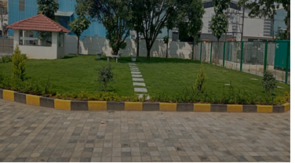
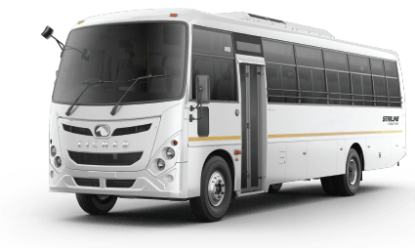
About AirWays
Notes:
Audio script:
Our next destination is situated across the river. Don’t worry, the bus will take you to the cruise station. To get the cruise ticket, you need to complete a quiz. Why don’t you try it on the way?

Slide 29



Knowledge Check 1
Given below is the list of operations carried out under five major operating segments at AirWays. Can you match the operations with the operating segments?
Rearrange the operating segments in front of correct operations and then select Submit.
Delivers industry-leading equipment, components and software that serves the vehicle service, environmental solutions and industrial markets
Imaging and Identification (InI)
Provides a comprehensive portfolio of safety and efficiency solutions for the convenience retail, fueling and clean energy, cryogenic gas and vehicle wash markets
Engineered Products (EP)
Leads the design and manufacture of equipment, consumables and software, and provides support services for the digital printing and product identification markets
Climate and Sustainability Technologies (CST)
Creates performance critical solutions and products for the safe handling of fluids across the chemical, hygienic, biopharma, oil and gas and industrial markets
Clean Energy and Fueling (CEF)
Develops and supplies innovative and energy efficient equipment and systems, that serve the commercial refrigeration, heating and cooling and beverage packaging equipment markets
Pumps and Process Solutions (PPS)
Notes:
Audio script:
You studied about the five major operating segments at AirWays and how they function. Given below is the list of operations carried out under each segment. Can you match the operations with the correct operating segments?
Rearrange the operating segments in front of correct operations and then select Submit.
Media Notes:
The correct matches are indicated by matching colors in storyboard for reference.

Slide 30
Knowledge Check 1
That’s correct/Not quite.
The correct matches are indicated below.
Delivers industry-leading equipment, components and software that serves the vehicle service, environmental solutions and industrial markets
Engineered Products (EP)
Provides a comprehensive portfolio of safety and efficiency solutions for the convenience retail, fueling and clean energy, cryogenic gas and vehicle wash markets
Clean Energy and Fueling (CEF)
Leads the design and manufacture of equipment, consumables and software, and provides support services for the digital printing and product identification markets
Imaging and Identification (InI)
Creates performance critical solutions and products for the safe handling of fluids across the chemical, hygienic, biopharma, oil and gas and industrial markets
Pumps and Process Solutions (PPS)
Develops and supplies innovative and energy efficient equipment and systems, that serve the commercial refrigeration, heating and cooling and beverage packaging equipment markets
Climate and Sustainability Technologies (CST)
Notes:
Audio script:
That’s correct/Not quite.
The correct matches are indicated below.
Media Notes:
Show feedback on clicking submit button.

Slide 31

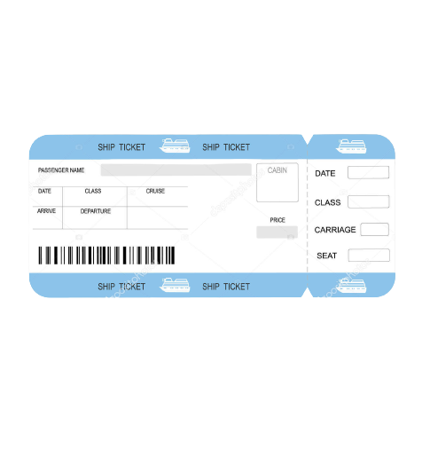
About AirWays
Notes:
Audio script:
Well done! You got your cruise pass. Let’s begin the journey to our next destination.
Media notes:
None

Slide 32

My Personal Development at AirWays
Notes:
Audio script:
In module 2, you will learn about how can you achieve your personal development goals at AirWays.

Slide 33

My Personal Development at AirWays
Next part of the module is covered as a journey inside the cruise
Likewise, all three modules are completed.
Notes:
Audio script:
None

Slide 34
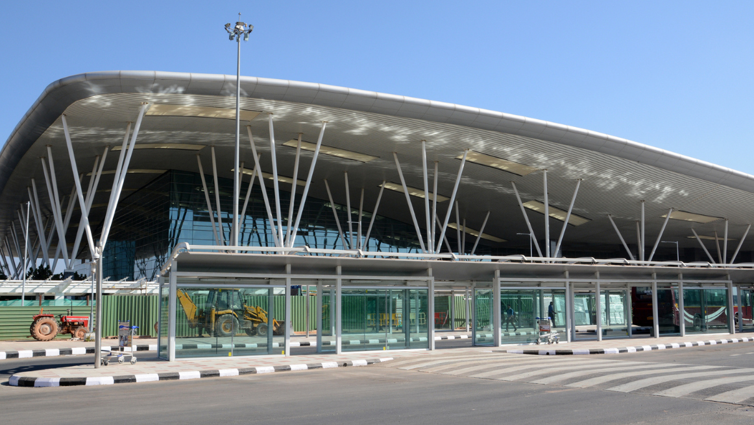
Notes:
Audio script:
You’ve reached the end of the induction training program. Let’s fly back to where we started from.
Media notes:
Show same airport again as in the beginning of the module.

Slide 35
Course Summary
Who we are and what we do at AirWays?
Over 200 manufacturing, warehouse and sales/service locations around the globe
5 major operating segments – Engineered Products (EP), Clean Energy and Fueling (CEF), Imaging and Identification (InI), Pumps and Process Solutions (PPS), Climate and Sustainability Technologies (CST)
Unique business model approach
History and evolution of AirWays Airlines till date since its foundation
Notes:
Audio script:
Would you like to have a quick recap of the key points we covered in the course?
Media notes:
Inside of the plane, on a magazine page, the key points animate one by one. Show text “Next page” at the bottom, and make it clickable.
Person holding a tab or magazine.

Slide 36
Course Summary
My Personal Development at AirWays
Key points to be listed
Notes:
Audio script:
None
Media notes:
Inside of the plane, on a magazine page, the key points animate one by one. Show text “Next page” at the bottom, and make it clickable.

Slide 37
Course Summary
My Learning Opportunities at AirWays
Key points to be listed
Notes:
Audio script:
None

Slide 38
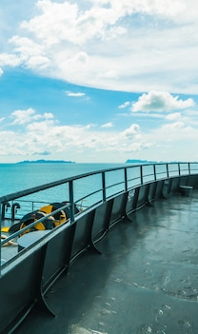

My Learning Opportunities at AirWays
My Personal Development at AirWays
About AirWays
You have successfully completed the course on
Getting on Board
Select Exit to close this window.
Exit
Notes:
Audio script:
Congratulations! You have successfully completed the journey across AirWays Airlines. This completes the induction training program. You are now all set for your new role here. Good luck!
Select Exit to close this window.

