Slide 1
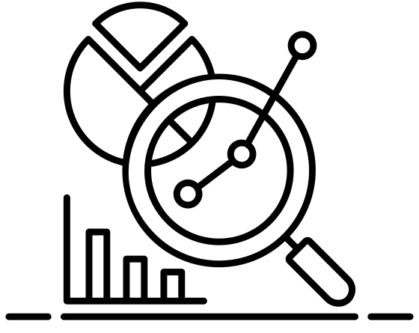
L02-landing-welcome-page-003
Topic 0 | Screen 0
Welcome back to Keys Academy!
In the previous course, we saw how we addressed the challenges during IT monitoring and analytics.
We saw how we addressed challenges of…
Monitoring and analytics
<>

Slide 2
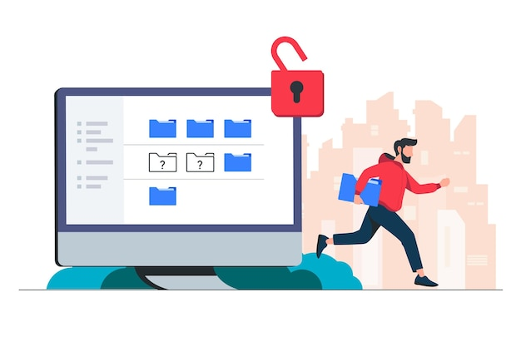


In this course, we will cover challenges related to ransomware protection along with associated solutions.
Course 2: Ransomware and Data Security
This course covers challenges of ransomware protection and associated solutions.
START
Global for all icons and images: the hyperlinks are embedded within the images.
Make sure that your headphones or speakers are connected and working.
A transcript is also available on every audio screen.

Slide 3


L12-summary-001
Topic 0 | Screen 1
Course Objectives
As you progress through the course, you will be able to:
Before you proceed, take a look at the course objectives listed on screen.
Stop malware in its tracks before it enters your backups.
Prevent malicious tampering with end-to-end immutability.
Ensure your data is recoverable with SureBackup.
Restore your data quickly with the pioneer of instant recovery.
Use the suggested image as a background for this screen.

Slide 4
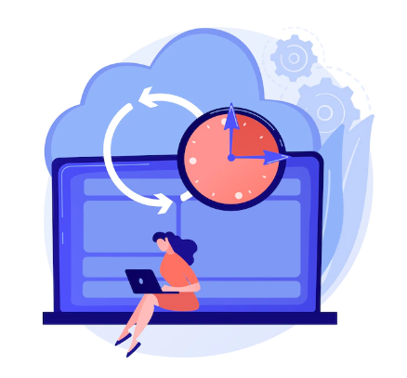


vh02-visual-menu-004
Topic 0 | Screen 2
Course Journey
Here are the topics covered in this course.
Completing a topic brings you back to this screen and allows you to choose the next topic.
Select a topic to proceed.
Here are the topics covered in this course. Completing a topic brings you back to this screen and allows you to choose the next topic.
Introduction to Ransomware
1
Detect Ransomware
2
Protect Your Data
3
Verify Backups
4
Instantly Recover
<>
5
Summary
6
COMPLETED
SUCCESSFULLY
COMPLETED
UNSUCCESSFULLY
-
IN PROGRESS

Slide 5

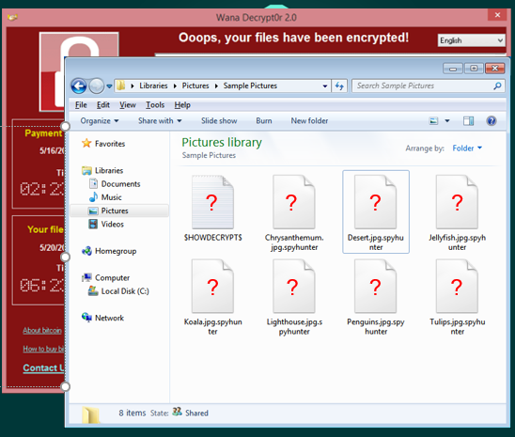



Topic 1 | Screen 1 (a)
What Is Ransomware?
Ransomware is:
Ransomware is a malicious software that aims to sabotage your data, locking it and making it unusable, with the attacker forcing you, the victim, to pay a ransom to unlock it.
Malicious software
Sabotages your data
Makes data unusable
Icons and text will appear one by one in sync with audio.
Forces you to pay a ransom

Slide 6
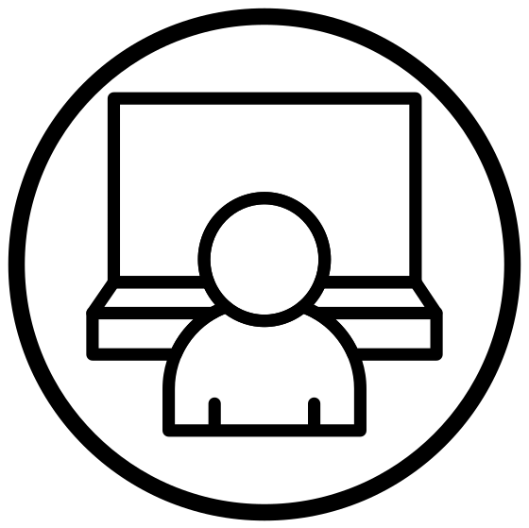



Topic 1 | Screen 1 (b)
What Is Ransomware?
It prevents users from accessing their devices by locking their computers, or prevents users from accessing their data by encrypting it, and even deleting your backups, so you can’t recover them from somewhere else.
Computer locked!
Data encrypted!
No backups found!
Icons and text will appear one by one in sync with audio.

Slide 7




Topic 1 | Screen 1 (c)
What Is Ransomware?
It copies your data as well, so they can double extort you by threatening to go public with your data, or even triple extort by going to your customers and threatening with the same.
Double extort
Threatening to go public
Copies your data
Triple extort
Icons and text will appear one by one in sync with audio.
Threatening the Customer

Slide 8
Topic 1 | Screen 2 (a)
Because of what Ransomware does, it truly is a disaster. By failing to prepare for it, customers are basically preparing to fail.
Character image
Ransomware is a disaster
By failing to prepare, you are preparing to fail…
Icons and text will appear one by one in sync with audio.
This will be an AE video with the SME explaining content. He will be in the frame.

Slide 9
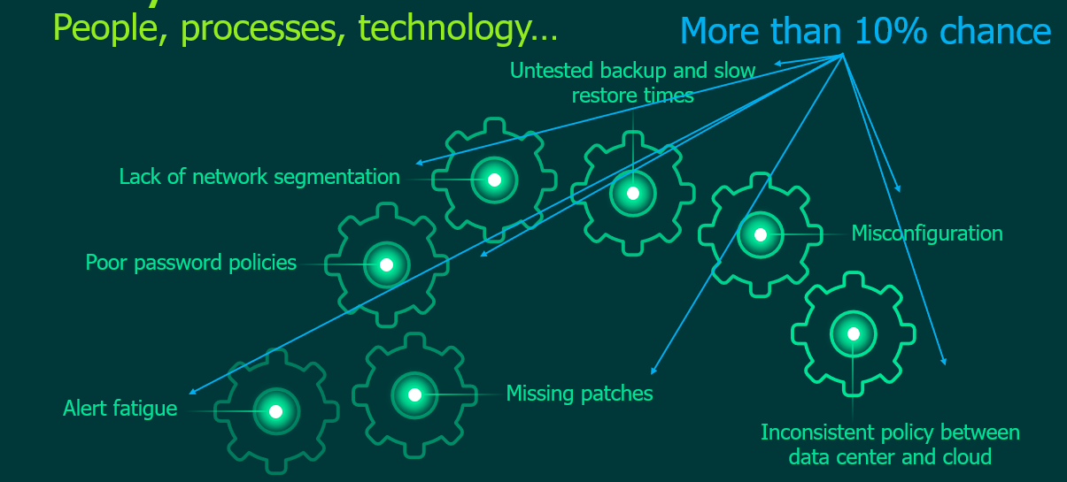
Topic 1 | Screen 2 (b)
Ransomware Is a Disaster
Ransomware got so effective, because there are a lot of components in IT to deliver services, that need constant updates and protection, against an accelerated number of threats that keep appearing almost on an hourly basis.
Why is ransomware effective?
Character image
Icons and text will appear one by one in sync with audio.
This will be an AE video with the SME explaining content. He will be in the frame.
Need constant updates and protection against frequent threats

Slide 10
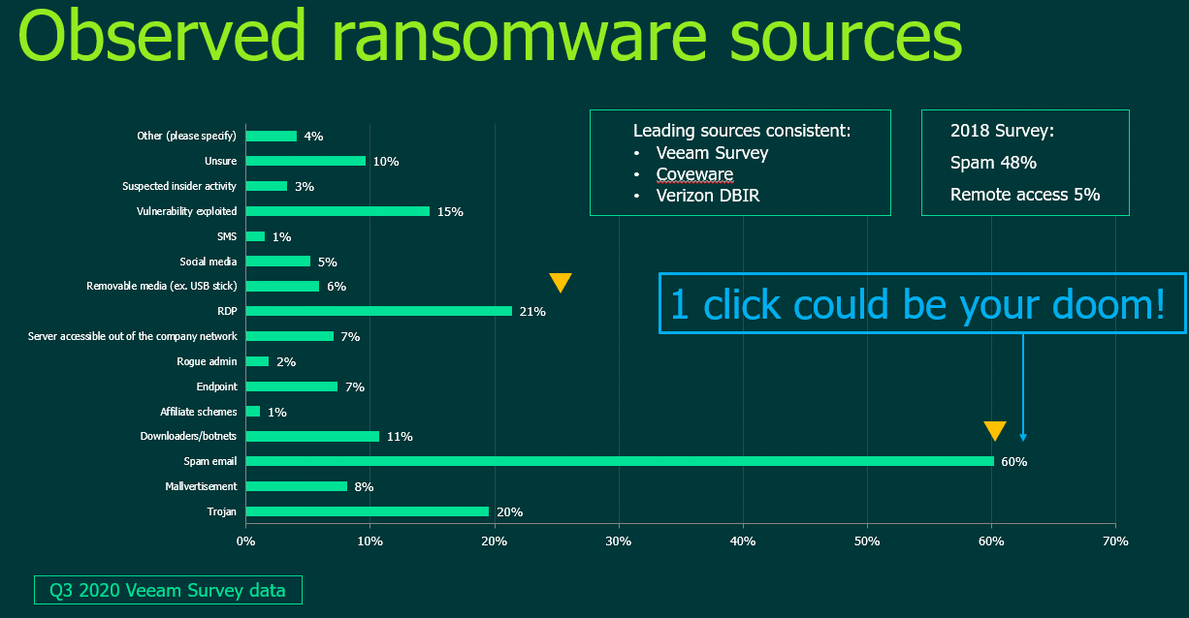
Topic 1 | Screen 2 (c)
Ransomware Is a Disaster
Why is ransomware successful?
One of the main reasons of ransomware being so successful, is due to the methodology of its delivery systems.
Methods of delivery
<>

Slide 11
Topic 1 | Screen 2 (d)
Ransomware Is a Disaster
A simple click from one of the company’s employees on an infected attachment or link in an e-mail, could potentially open a pandora’s box, and create enough access for hackers to start exploiting other company resources for vulnerabilities.
Why is ransomware successful?
Clicking an infected attachment or link in an e-mail could create enough access for hackers
<>

Slide 12

Topic 1 | Screen 2 (e)
Ransomware Is a Disaster
So it is just a matter of WHEN and not at all IF Ransomware will be successful in getting a company’s data, and they should be prepared for it by all means, especially with data protection, as in general, not all data can be recovered EVEN after paying the ransom.
It’s a matter of WHEN and not IF
Character image
64%
Be prepared with data protection
Data can be recovered after paying ransom, on average
Icons and OST will appear in sync with audio.

Slide 13
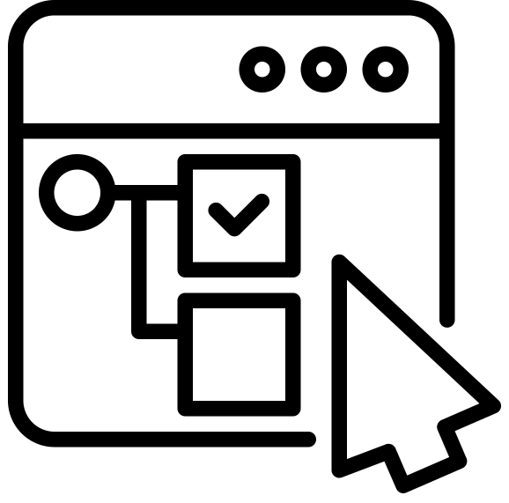
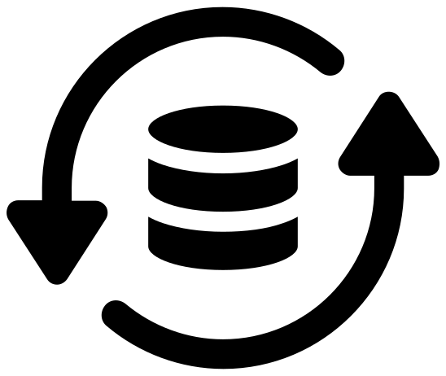
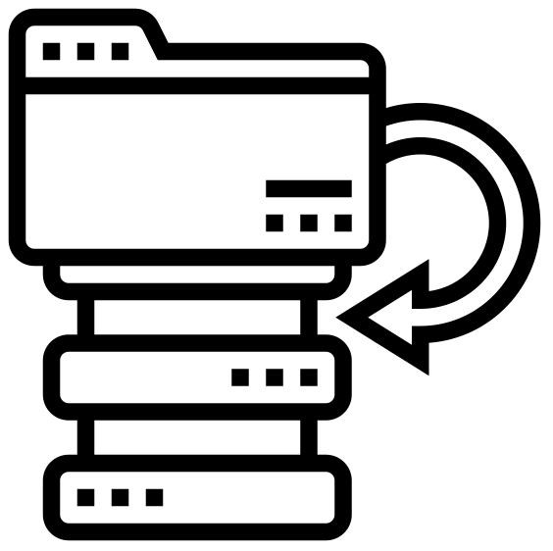
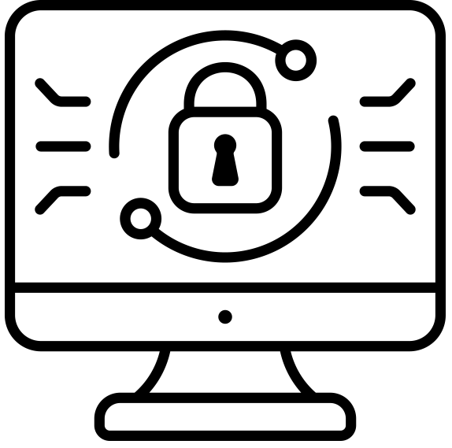
Topic 1 | Screen 3 (a)
Challenges with Legacy Backup Solutions
There are many Ransomware and Data Security challenges, that legacy backup solutions could simply not cover, due to their limitations on keeping up with modern datacenters and their requirements in this area, such as automated testing of the backed up data, fast restores, DR readiness and even not having backups for data deleted by ransomware.
Legacy backup solutions have limitations on keeping up with modern datacenters and their requirements such as:
Automated testing of backed up data
Fast restores
DR readiness
Backups for deleted data
Icons and OST will appear in sync with audio.

Slide 14


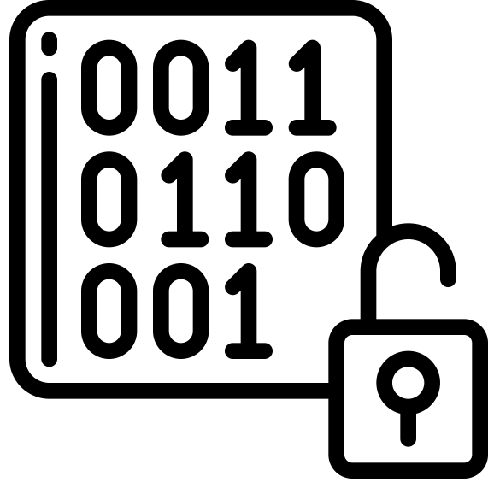
Topic 1 | Screen 3 (b)
Challenges with Legacy Backup Solutions
So organizations infected by it, would rather pay the ransom instead of trying to recover it from backups, and restore what they can faster, by decrypting whatever they can.
Organizations would:
Pay ransom
Restore faster
Icons and OST will appear in sync with audio.
Decrypting data

Slide 15

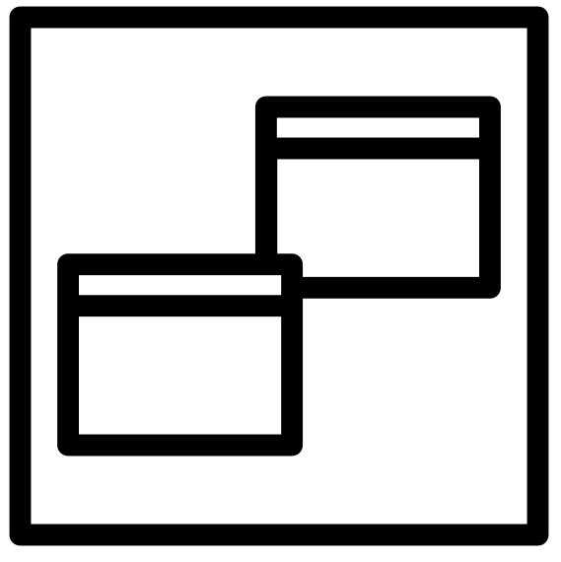
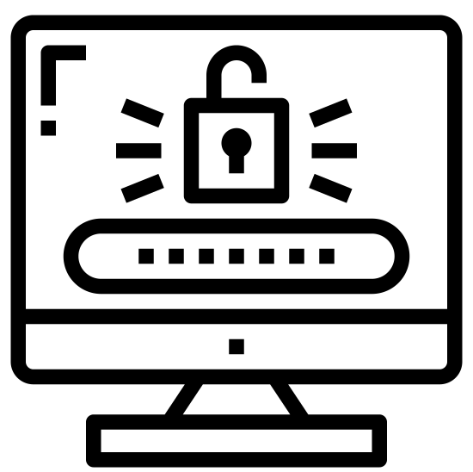


Topic 1 | Screen 4
Ransomware and Data Security Challenges
Keys is different than legacy backup solutions. Take a quick look at the main ransomware and data security challenges and then select the button to know what solutions Keys can offer.
Effectively restore malware-free data after a ransomware incident
Be able to protect data from malicious attacks, which could impact your company brand
Slow recovery makes paying a ransom the faster alternative
Supporting frequently changing regulations and ensuring compliance requirements are met
Icons and OST appear in sync with audio.
Keys Solutions
Select the button to learn more.

Slide 16
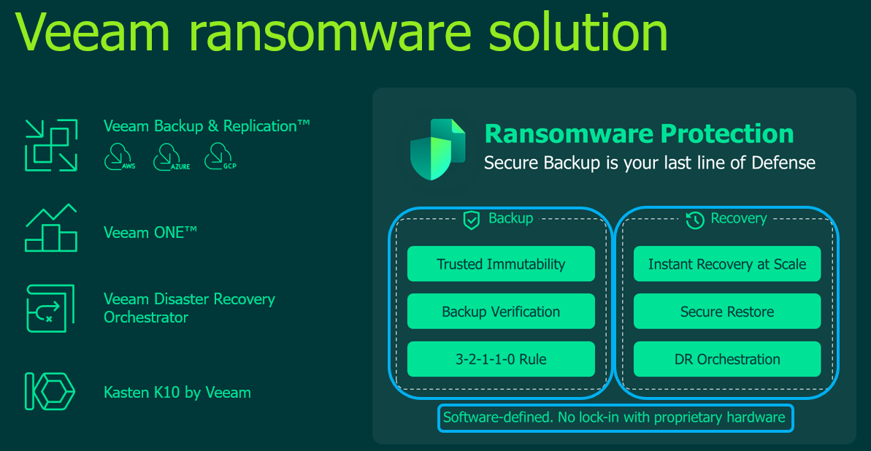
Topic 1 | Screen 5 (a)
Keys Solutions
Keys can reduce the time and effort it takes to recover ALL data from a successful ransomware attack, through the vast number of backup and recovery solutions embedded in its platform.
KEYS
Reduces time and effort it takes to recover ALL data from successful ransomware attacks
Keys ransomware solution
Treat this and the next three slides as a carousel.

Slide 17

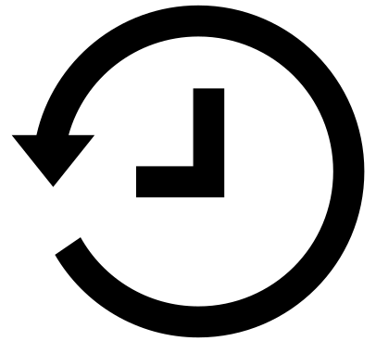
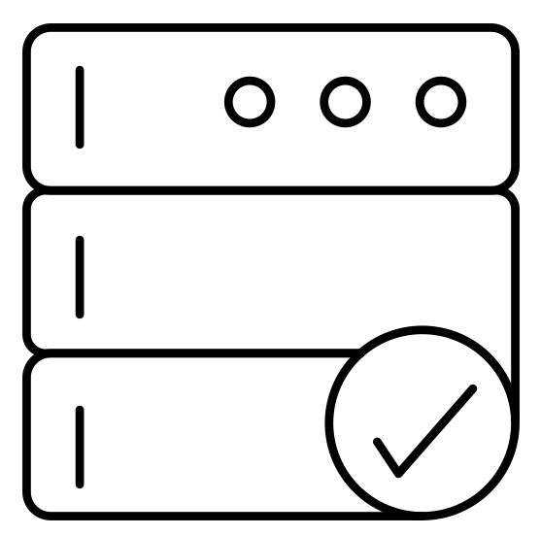



Topic 1 | Screen 5 (b)
Keys Solutions
<>
KEYS
Reduces time and effort it takes to recover ALL data from successful ransomware attacks
Ransomware protection
Backup
Recovery
Trusted Immutability
Instant Recovery at Scale
Backup Verification
Secure Restore
<>
3-2-1-1-0 Rule
DR Orchestration

Slide 18
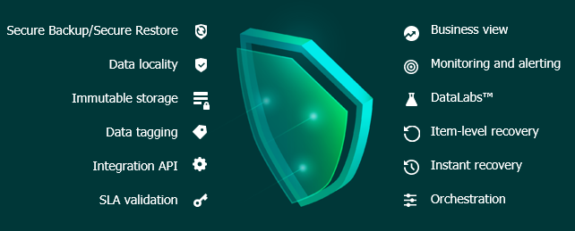
Topic 1 | Screen 5 (c)
Keys Solutions
<>
KEYS
Reduces time and effort it takes to recover ALL data from successful ransomware attacks
Data security
Secure Backup/Secure Restore
Business view
Data locality
Monitoring and alerting
Immutable storage
DataLabs™
Data tagging
Item-level recovery
<>
Integration API
Instant recovery
SLA validation
Orchestration

Slide 19
Topic 1 | Screen 5 (d)
Keys Solutions
<>
KEYS
Reduces time and effort it takes to recover ALL data from successful ransomware attacks
Data security
True immutability
fully protects data from attacks
safely restores malware-free
Secure backup
protects workloads and data
ensures there’s no errors through automated testing and verification
Instant recovery
makes data restoration less expensive than paying a ransom
Orchestration
fully automates and documents complex workflows, including non-disruptive, large-scale recovery testing
<>

Slide 20

<Topic Title>
L06-kc-samc-001
Topic 1 | Screen 6
Knowledge Check
What is the main challenge faced by the legacy backup solutions to protect data from ransomware?
Let’s pause here to check your understanding about the topic. Answer the questions on the screen and then select submit.
Select the correct option and Submit.
Limitations on keeping up with modern datacenters and their requirements
The slow recovery, which makes paying ransom a faster alternative
The amount of data that can be recovered after ransomware attack
Data is copied by ransomware followed by threatening to make it public
Submit
<>

Slide 21
--
--
--
<>
That’s correct/incorrect.
The legacy backup solutions face many challenges in terms of data protection and recovery, due to their limitations on keeping up with latest technology. However, the main challenge is the speed of data recovery, due to which paying a ransom becomes a faster alternative to recover the lost data, by decrypting whatever they can.
<>

Slide 22
<Topic Title>
L07-kc-mamc-001
Topic 1 | Screen 7
Knowledge Check
How is Keys effective than the legacy backup solutions in terms of data recovery?
<>
Select the correct options and Submit.
It safely restores data, malware-free
It reduces time and effort it takes to recover ALL data from successful ransomware attacks
It makes data restoration less expensive than paying a ransom
It allows instant recovery at scale
Submit
<>

Slide 23
--
--
--
<>
That’s correct/incorrect.
Keys offers all these and many more solutions for safe and effective data recovery. Unlike legacy backup solutions, Keys reduces the time and effort it takes to recover ALL data from a successful ransomware attack, through the vast number of backup and recovery solutions embedded in its platform.
<>

Slide 24



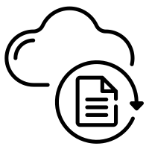
L01-text-image-001
Topic 6 | Screen 1
Conclusion
This module is now complete. Thank you for your time. You should now be able to:
Stop malware in its tracks before it enters your backups
Prevent malicious tampering with end-to-end immutability
Ensure your data is recoverable with SureBackup
Restore your data quickly with the pioneer of instant recovery
Stop malware from entering your backups
Restore data quickly
Ensure data is recoverable
Prevent malicious tampering
Icons and OST will appear in sync with audio.

Slide 25
m01-cl-buttons-001
Topic 5 | Screen 2
Thank You!
You have come to the end of this course. We recommend the following courses for you next.
You have come to the end of this course. We recommend the following courses for you next.
Course 5: DR Orchestration
Course 6: Hybrid Cloud Acceleration
Exit

